Slide 1
The Cybersecurity Mindset
Cybersecurity 101 Day 1

Slide 2
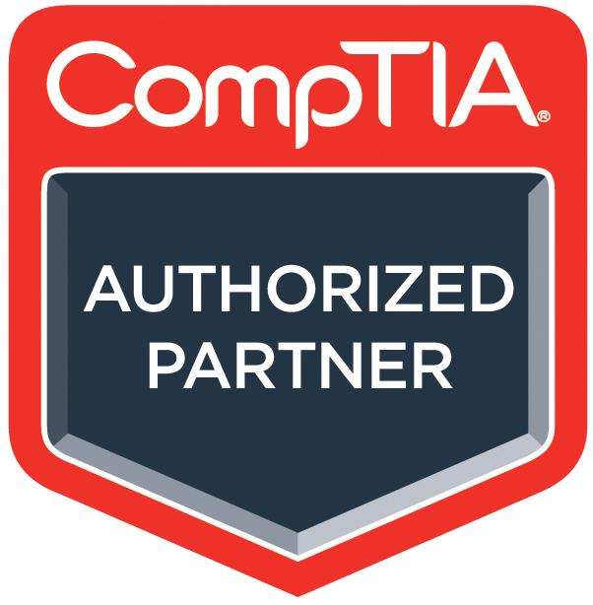
All students will receive access to CompTIA CertMaster Practice for Security+.
All graduates in good standing will receive CompTIA Exam Voucher Choice.
The CompTIA CertMaster Practice for Security+ is an adaptive knowledge assessment and certification training companion tool that helps you prepare for the Security+ CompTIA exam.
It features question-first design, real-time learning analytics, and content refreshers to reinforce and test what you know and close knowledge gaps.
You will receive access later in the course when it is covered.
Upon graduating in good standing, you will receive a CompTIA Exam Voucher for one of the following exams:
Security+, Network+, Linux+, Server+, or Cloud+
If you choose a voucher other than Security+, you will receive access to a second Certmaster practice tool that aligns with your choice.
Your Career Director will be available to help you decide which voucher is best for you based on your skill set and professional goals.
Vouchers will be sent via email and are valid for 12 months.
‹#›

Slide 3

Class Objectives
By the end of today’s class, you will be able to:
Explain the course structure and general direction of the program.
Recognize the high-level security strategies and tools covered in class.
Define cybersecurity as the assessment of threats and the mitigation of risk.
Give a clear definition of the CIA triad and its elements.
‹#›

Slide 4
The Rising Cyber Threat
‹#›

Slide 5

Why is cybersecurity such a desired skill these days?
Notes:
Image Source: AdobeStock_125741492

Slide 6
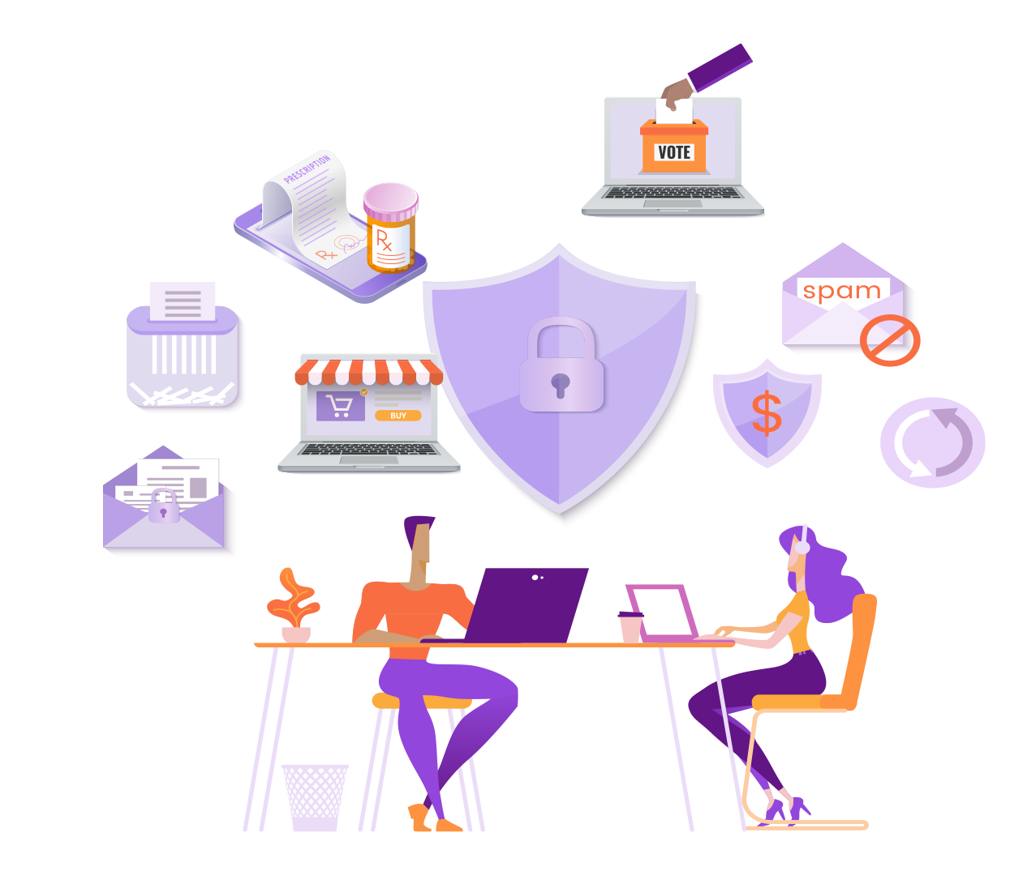
Reason 1: Explosive Growth in Dependence of IT
Nearly every personal, social, and commercial aspect of our lives makes contact with vulnerable IT infrastructure.
Notes:
Image sources: Shutterstock_1187923168 (couple at table); shutterstock_415082218 (online shopping); shutterstock_1177745851 (online prescription); shutterstock_1094829206 (online voting)

Slide 7

Reason 2: More Users (Targets) on Connected Devices
More people than ever before are logged into connected devices— often for the majority of their waking (and sleeping) hours.
Notes:
Image source: shutterstock_1075031486

Slide 8
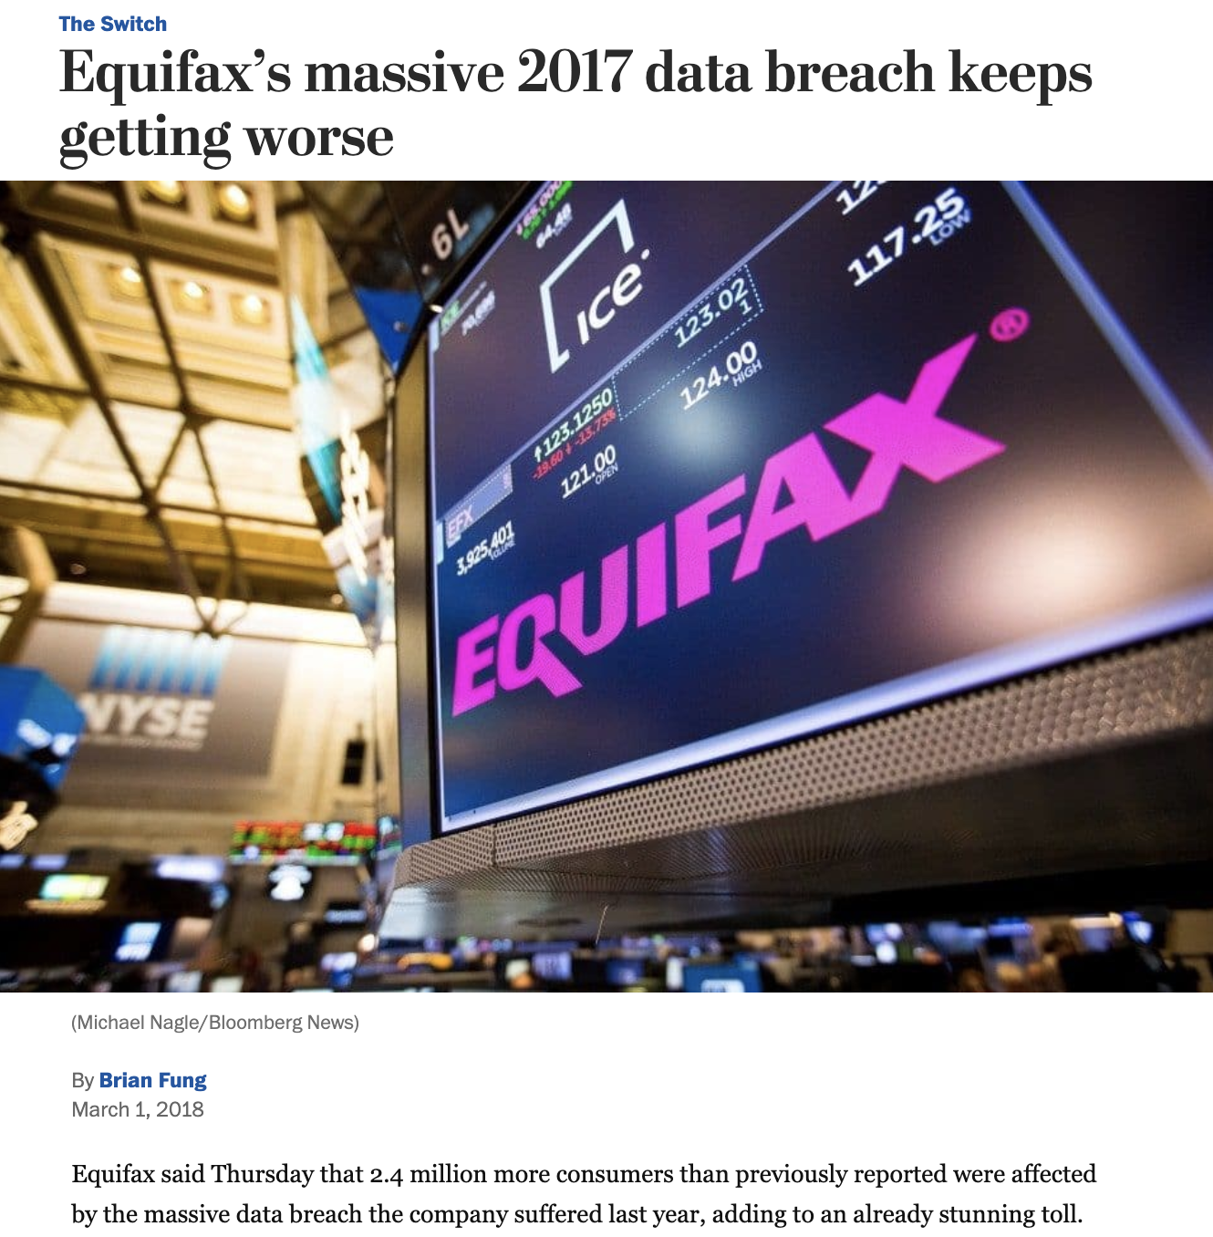
Reason 3: Better Tools for Bigger Damage
Today’s cyberattacks are becoming more sophisticated, aggressive, and disruptive than ever before.
Notes:
Low-Risk Image: Source https://www.washingtonpost.com/news/the-switch/wp/2018/03/01/equifax-keeps-finding-millions-more-people-who-were-affected-by-its-massive-data-breach/?noredirect=on&utm_term=.f63014925b4a

Slide 9
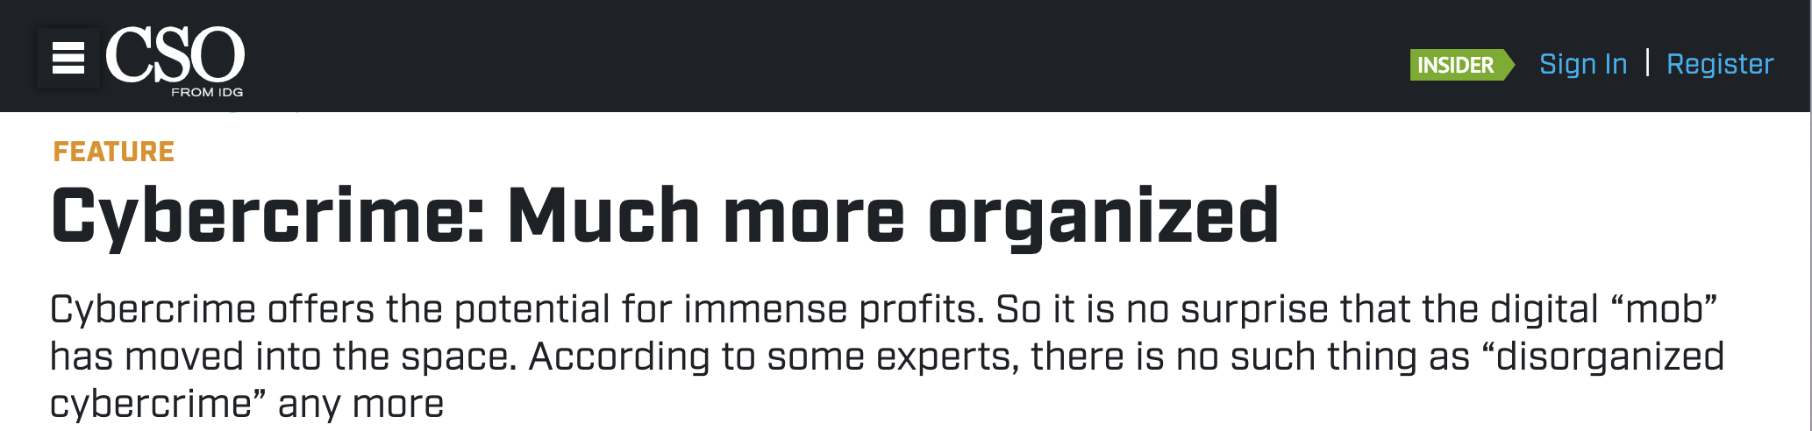
Reason 4: Significant Investment by Bad Actors
The field was once populated by individual “lone attackers.” It has now become a focal point for organized crime, nation states, and private enterprises.
Notes:
Headline source: https://www.csoonline.com/article/2938529/cybercrime-much-more-organized.html

Slide 10

Reason 5: Dire Shortage of Skilled Professionals
According to studies by (ISC)², there will be over 1.5 million unfilled cybersecurity positions by 2020.
“70% of cyber security professionals say that their organization has been impacted by the ongoing global cybersecurity skills shortage.”
Notes:
Quote Source: ESG Research Report, The Life and Times of Cybersecurity Professionals, November 2017
Image source: shutterstock_741657592

Slide 11
Defining Cybersecurity

Slide 12
What is the first thing the word “cybersecurity” brings to mind?
Notes:
Image Source: AdobeStock_125741492

Slide 13
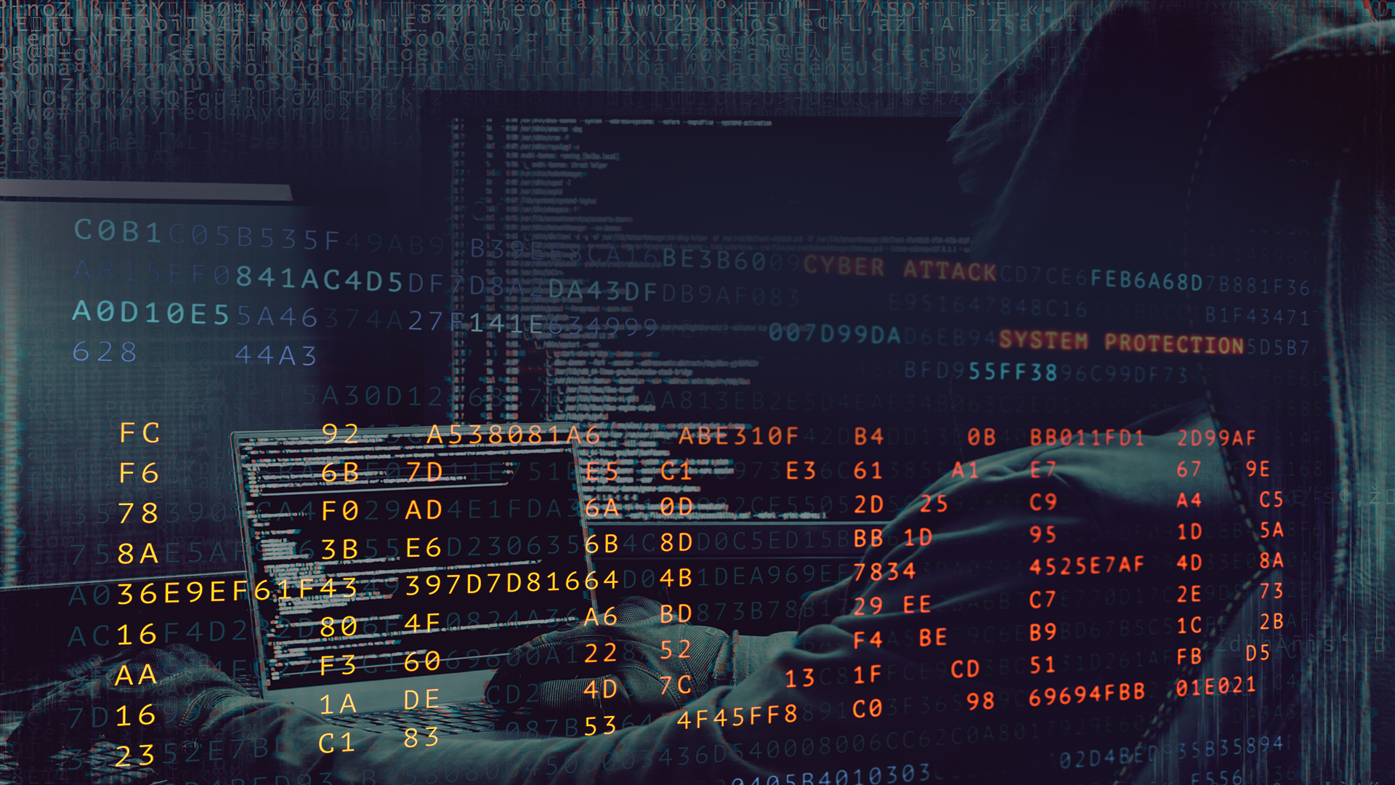
Everyone’s First Thoughts:
Attackers and complicated code...
Notes:
Image sources: shutterstock_581898457 (hoodie person in background); shutterstock_635676176 (HACKER word and code overlay)

Slide 14
But cybersecurity isn’t about
attackers and complicated code...

Slide 15

Cybersecurity is really about assessing threats and mitigating risks.
Notes:
Image source: Mike Mirandi

Slide 16

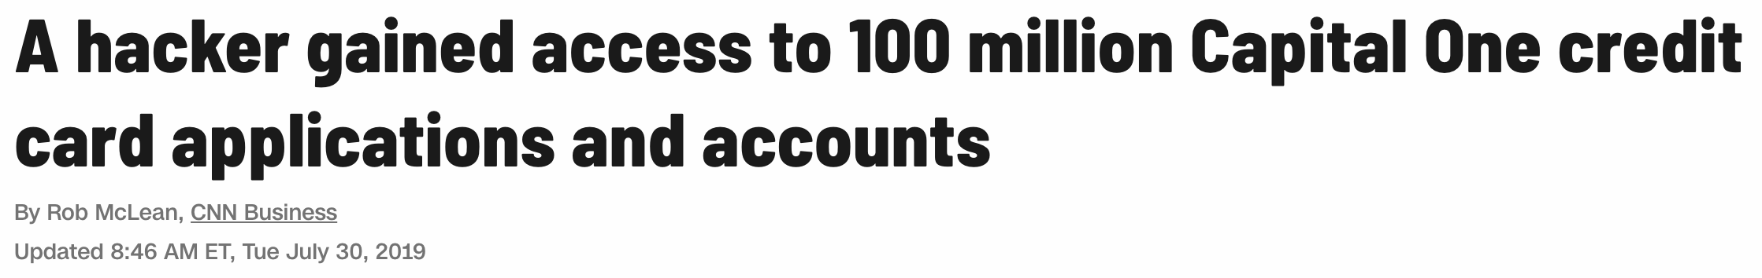
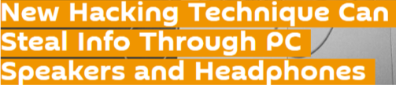
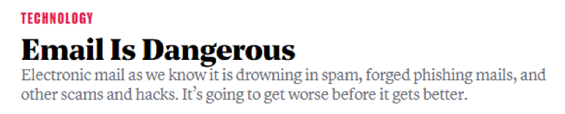

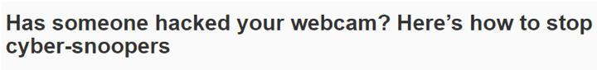

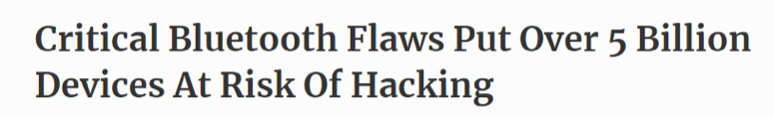
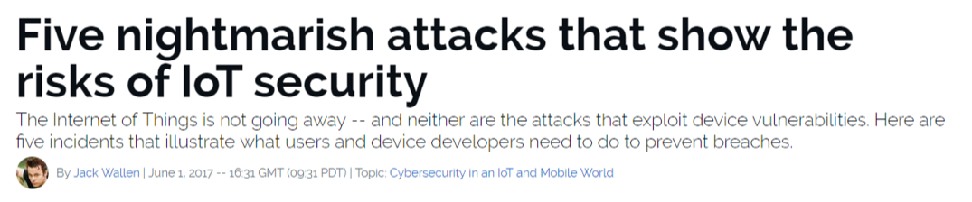
Know the Threats
To the experienced cybersecurity professional, risks are everywhere.
Notes:
Image source: shutterstock_1007525926

Slide 17

Mitigating Risks
Historically, organizations viewed cybersecurity from the lens of the castle model: Managing risks meant building walls and keeping the bad actors out.
Today, security professionals operate in a world where breaches are assumed, and risks associated with such events also need to be mitigated.
Notes:
Image sources: shutterstock_600449171 (castle); shutterstock_1014968650 (horse)

Slide 18
Course Overview

Slide 19
Daily Routine
In class, we’ll run through the following:
Objectives
Brief background lecture
Instructor demonstrations
Thought exercises
In-class skill builders
Project work

Slide 20
Curriculum at a Glance: Modules
01
Security Fundamentals
Learn to think like cybersecurity professionals by assessing threats and mitigating risks. Look at security from an organizational perspective via governance, risk, and compliance. Understand how security controls impact an organization and its employees.
02
System Administration
Linux and Windows systems administration. Practical experience working with the command line and commands that are prominent in IT roles. Configure and audit servers, and harden them from malicious attacks. Programming via Bash and PowerShell.
03
Networks and Network Security, and Project 1
Network configuration, design, protocols, and data communication. Network security, cryptography, and cloud virtualization and security. Project 1 involving the deployment of an ELK monitoring stack.
04
Offensive Security
Web applications, databases, and associated vulnerabilities and hardening. Windows and Linux penetration testing, using tools such as Nessus and Metasploit.
05
Defensive Security and Project 2
SIEM with Splunk. Setting up security monitoring, alerts, dashboards, and custom reports. Using forensic tools to recover deleted data. Project 2 involving attacking and monitoring vulnerable VMs.
06
Review and Final Projects
Certification prep and review. Interviewing and career prep practice. Final project involving deployment of a vulnerable web application, dashboard creation and live traffic analysis.

Slide 21
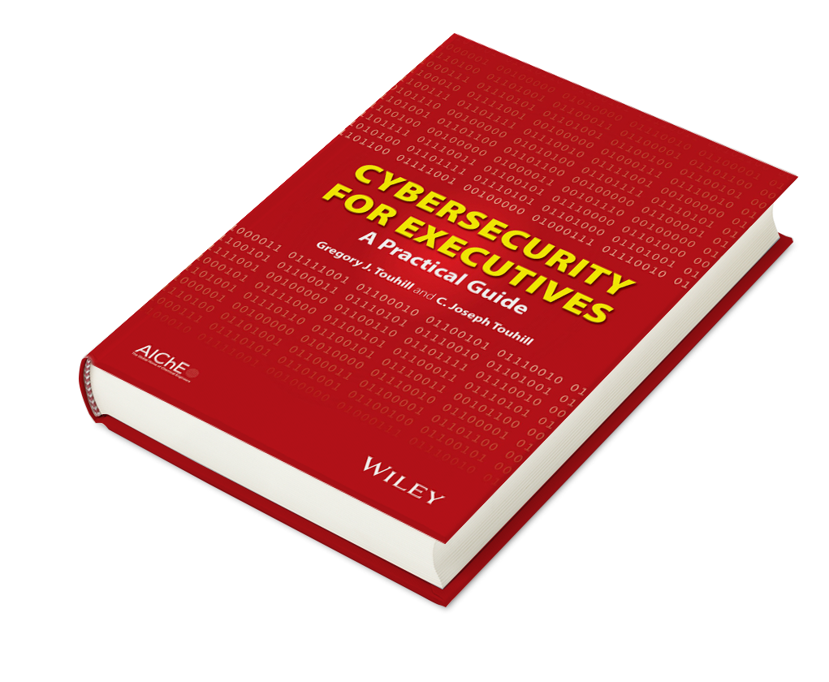
Example Activity: Cybersecurity Policy and Strategy
We’ll look at security in the larger context of an organization and how security teams communicate risks and strategies to non-technical stakeholders.
Cybersecurity for Executives: A Practical Guide, by Gregory J. Touhill (Author), C. Joseph Touhill (Author), Wiley-AIChE, ©2014
Notes:
Image source: shutterstock_199262867

Slide 22
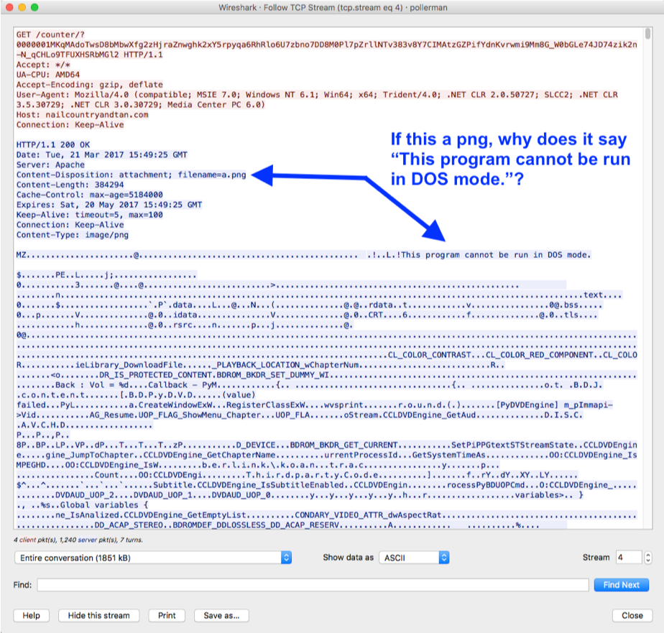
Example Activity: Analyzing Web Traffic for Suspicious Activity
We’ll learn to process complex network traffic logs to find evidence of malware being sent across networks.

Slide 23

Example Activity: Encryption / Decryption Systems
We’ll learn how modern cryptography works and how historic methods of encryption can be easily broken.
Plaintext
Ciphertext
Encryption
Readable message, file, or data
Encrypted message, file, or data
Key(s)
hello!
5a8dd3ad0756a93ded72b823b19dd877
Decryption

Slide 24




Example Activity: Web Application Hardening
We’ll learn how web applications can be defended against the most common attacks.
1. Attacker sends a script-injected link to victim (an email scam).
1
2
2. Victim clicks on link and requests legitimate website.
Attacker
Victim
4
10101001
100101010110101001111010100101010100010001010100010100111010100110010001100101001
3
4. Malicious script sends victim’s private data to attacker.
3. Victim’s browser loads legitimate site but also executes malicious script.

Slide 25
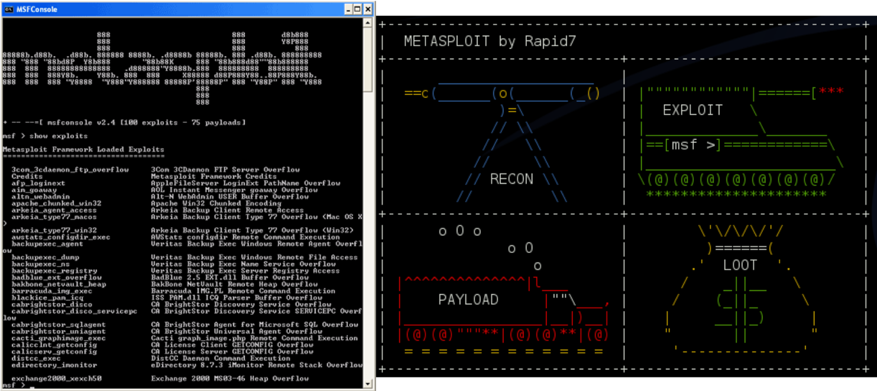
Example Activity:
Identify Vulnerabilities in Unpatched Systems
We’ll learn to use tools like Kali Linux, Nmap, and Metasploit to run penetration tests to identify known exploits.

Slide 26
Projects
These modules and assignments will culminate in three projects:
Red Team vs. Blue Team
ELK Stack
Final Project
The first project follows the Networking and Cloud Security units.
You will deploy an ELK monitoring stack within your virtual network.
You will work as penetration testers and SOC analysts to attack and monitor vulnerable VMs.
You will exploit a vulnerable web application, create dashboards to see alerts in real time, and analyze live traffic on a virtual network.
‹#›

Slide 27

Throughout the course, we’ll also work through Capture the Flag and class-long activities:
Find flags on a Linux server.
Investigate data packets and find flags that tie to various networking concepts.
Create a custom Security Operations Center and use our monitoring tools to analyze and protect an organization from potential attacks.
‹#›
Notes:
Image source: Greg Elzerman

Slide 28


Tools We’ll Use
We will use virtual machines to operate the various operating systems and tools throughout the curriculum.
Virtual machines allow us to run different operating systems.
We can download and install virtual machines onto our computer.
In cases where we need to use more than one virtual machine, we will access a network of those machines on the cloud.
‹#›
Notes:
AdobeStock_243484168

Slide 29



Tools We’ll Use: Virtual Machines
Vagrant local virtual machine
There are three categories of lab solutions that you will use throughout the course.
Azure Cloud Lab Services
Personal Azure Cloud accounts
‹#›

Slide 30

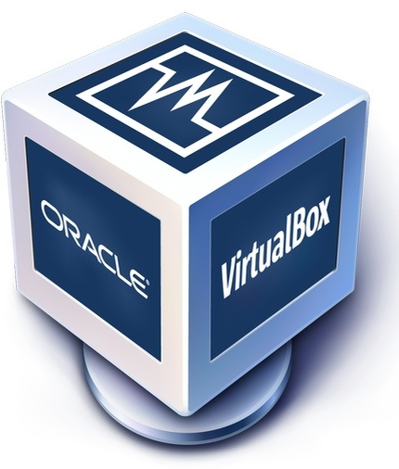

Tools We’ll Use: Vagrant Local Machines
Starting in Week 3, we will use a Linux Ubuntu virtual machine to complete many systems administration, networking, monitoring, programming, and other tasks.
VirtualBox is a virtualization tool we will use to run various lab activities. It allows us to run different operating systems on our local machines.
Vagrant is a tool we'll use to build and set up our virtual environments. It allows us to run scripts to install these virtual machines, which will then be run using VirtualBox.
Terminal or Git Bash: We will be using the command line to download, install, and access our machines.
(ubuntu.com)
‹#›

Slide 31
Tools We’ll Use: Vagrant Local Machines
We will be using Vagrant with VirtualBox in the following units:
Terminal
Networks I and II
Linux Systems Administration
Cryptography
Linux Archiving and Logging Data
Web Development
Bash Scripting and Programming
SIEM I and II
‹#›

Slide 32

Tools We’ll Use: Azure Lab Services
Other units will require the use of multiple virtual machines.
Can anyone think of why we would need to run multiple virtual machines at the same time?
‹#›
Notes:
AdobeStock_170811105

Slide 33
Tools We’ll Use: Azure Lab Services
We would need to run multiple virtual machines at the same time in order to:
01
Practice offensive security, we need an attacking machine and a vulnerable target machine. It would be unethical and most likely illegal to attack actual targets. So we need to set up dummy machines to attack.
02
Set up and monitor alerts during our defensive security units, we need a machine that is equipped with monitoring and alerting capabilities. We also need a machine to simulate an attack so we can test these monitors.
02
Ensure data and resources remain available if a main machine goes offline, we can create multiple machines to use as back ups.
‹#›

Slide 34
Tools We’ll Use: Azure Lab Services
Azure Lab Services will be used in the following units:
Windows Administration and Hardening
Network Security
Web Vulnerabilities
Pentesting I and II
Project 2: Red Team vs. Blue Team
Forensics
Final Project
‹#›

Slide 35
Online Learning
‹#›

Slide 36

In this section, we’ll take some time to discuss best practices for conducting this course in an online environment.
‹#›

Slide 37
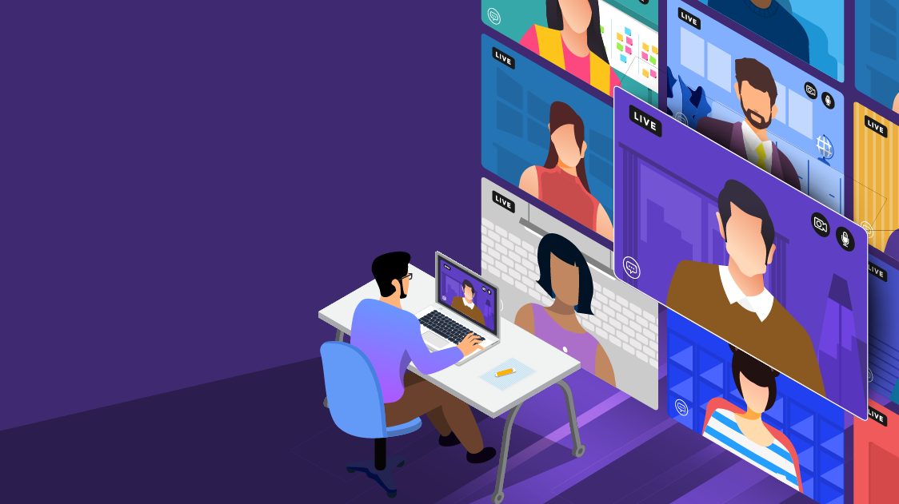
Tips: Online Learning
01
Get to know your classmates and instructors
You’ll get more out of the course if you feel like you’re part of a shared community.
Social connection can be difficult to develop through a computer screen, but there are ways to get to know your fellow classmates.
Participate in class and in your cohort’s Slack space.
You don’t have to get too personal, but you can share your specific security interest or career goals.
‹#›
Notes:
shutterstock_1686499531

Slide 38

Tips: Online Learning
02
Treat class time like you would a live class.
Try your best to make the area around you as distraction-free as possible.
If you can, go to a quiet room, silence your phone, and ask others in your home to avoid distracting you while you’re online.
‹#›
Notes:
shutterstock_1675575667

Slide 39

Tips: Online Learning
03
Budget time for classwork, homework, and review.
In an online environment, it can be harder to keep track of due dates for assignments.
Deliberately scheduling time throughout the week for your coursework will help.
Set aside three hours, three to four times per week for studying and doing homework.
Your work won’t seem as overwhelming this way, and you won’t be working on assignments last minute!
‹#›

Slide 40

Best Practices
Help make online learning as productive and easy as possible with these guidelines:
01
Always mute. If you are not presenting, put yourself on mute.
02
Include your first and last name for your screen name. Help everyone get to know you by including your full name.
03
Keep your video on. Be present during the online class. This includes showing your face.
04
Raise your hand in Zoom or use Slack for questions. Don't interrupt a lecture. Use the hand raise feature in Zoom or ask the question via Slack.
05
Use headphones with a microphone. Background noise and feedback echoes can be an issue when using your computer mic and speakers.
‹#›

Slide 41

Slack is an online communication tool that is like a forum, instant messenger, and email all rolled into one. It’s a tool used by countless organizations worldwide, and you'll be using it every single day for the next six months.
We will use Slack to send code snippets during class, share important announcements, and facilitate group exercises.
You should have received the link to your class-specific channel during orientation.
Though there is a Slack web application, for this course you should have the program installed on your machine.
‹#›

Slide 42
After the break, we will divide into breakout groups and get started on our first activity!
‹#›

Slide 43

‹#›
Notes:
Image source: AdobeStock_56885471

Slide 44

Assessing Threats: A Wild USB Appears!
Let’s say we found a USB drive laying on the ground. How much of a threat could that really be?
Let’s find out!
Notes:
Image source: shutterstock_131952674

Slide 45
A Wild USB Appears!

Slide 46



Activity: A Wild USB Appears!
In your breakout groups, discuss the following scenario and questions:
When plugged into a computer, the USB drive immediately executes running code.
How is a USB drive able to do this?
Why can't our computer stop the drive from running?
How might we defend against USBs like this?
Suggested Time: 12 Minutes

Slide 47
‹#›

Slide 48
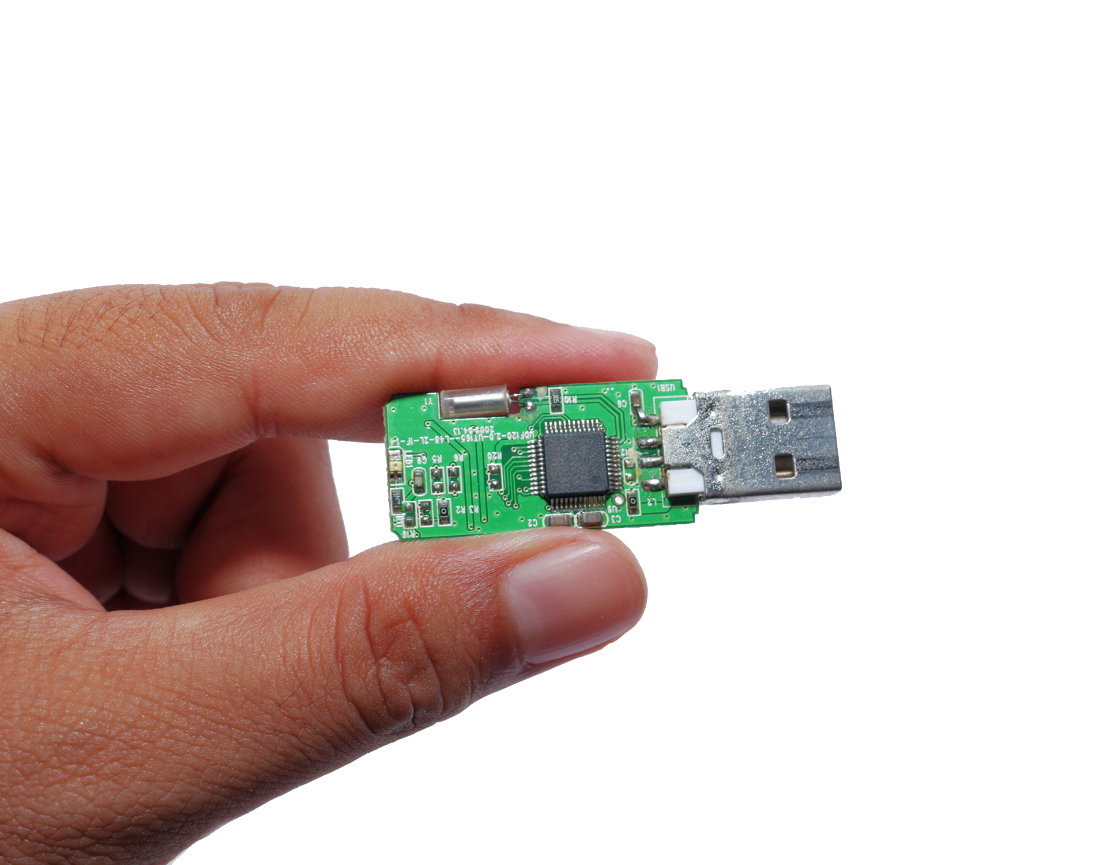
A Harmless USB?
What if the USB was a mini keyboard emulator?
When connected, our computer registers it as a keyboard allowing it to kick off without restriction.
Like most threats, their appearances are deceptive and seemingly safe.
Notes:
Image source: shutterstock_1280708755

Slide 49
The CIA Triad

Slide 50

Now, we will move on to our first concept: the three cornerstones of information security, known as the CIA triad.
1
Confidentiality
2
Integrity
INFORMATION
SECURITY
3
Availability
Notes:
Image source: shutterstock_708213337 (shield)

Slide 51
What do each of these words mean to you?
Confidentiality
Integrity
Availability
Notes:
Image Source: AdobeStock_125741492

Slide 52

Confidentiality
The state of being kept secret or private.
This corner of the CIA triad is all about ensuring sensitive information does not reach unauthorized people.
Examples of confidentiality attacks include uploading private photos and communications onto a forum and exposing credit card numbers online.
Confidentiality comes down to the principle of “need to know.” Data or information should only be made available to those who need access to it.
Confidentiality is enforced through measures like encryption and authentication.
1
Confidentiality

Slide 53
Integrity
The quality of being honest, whole, or undivided.
The integrity of information refers to protecting information from being modified by unauthorized parties.
Examples of integrity attacks include intercepting money transfers and changing the dollar amount in seemingly insignificant ways, so the excess can be sent elsewhere, and altering university grades to be better or worse.
Integrity attacks can be avoided by using
a secure hashing algorithm and process
when transferring data to ensure it
isn’t tampered with in transit.
2
Integrity

Slide 54
Availability
The quality of being able to be used or obtained.
Availability concerns occur when operating systems, equipment, and data are not functioning correctly, limiting accessibility to those who need it.
Examples of availability attacks include bad actors taking down a web-connected generator and disabling a critical power supply, and using a denial of service attack to bring down a financial service provider’s website, making it impossible for clients to make transactions.
Creating regular backups of data is one way to maintain availability.
3
Availability

Slide 55
We will revisit these terms regularly throughout the course, and explain how various topics, skills, and practices are concerned with protecting each.
1
Confidentiality
2
Integrity
INFORMATION
SECURITY
3
Availability
Notes:
Image source: shutterstock_708213337 (shield)

Slide 56
Activity: CIA Triad Security Scenario
In this activity, you will analyze a variety of brief security scenarios and identify which element of the CIA triad (confidentiality, integrity, availability) each situation is concerned with.
12 Minutes

Slide 57
‹#›

Slide 58
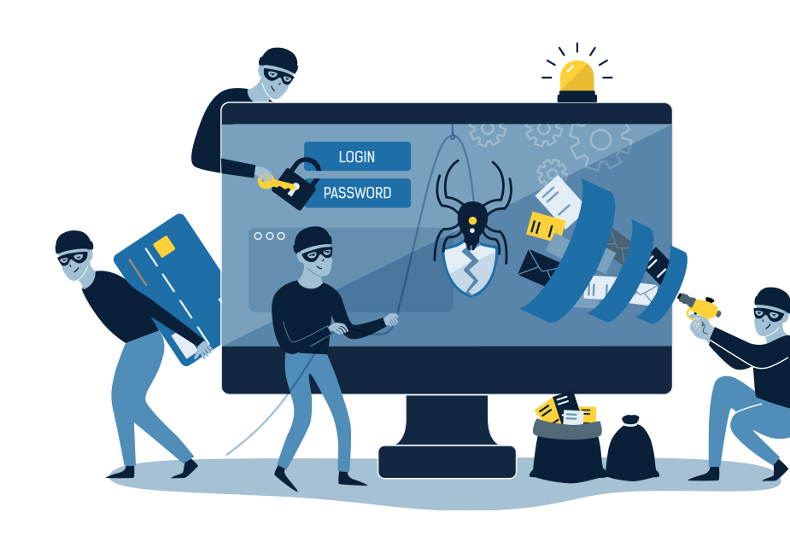
Next Class
We will dive deeper into assessing risk and mitigating threats by evaluating specific attacks and vulnerabilities of users, web applications, servers and databases.

Slide 59
Any Questions?

